Slide 1
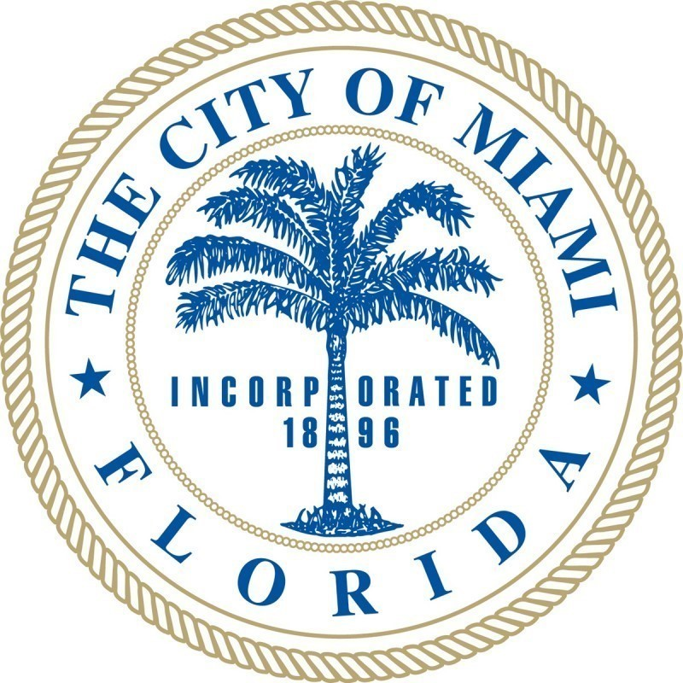
Basic Pre-Disaster Planning
Understand FEMA emergency and exigency definitions
Know and understand current insurance coverage
Identify assets – facilities, parks, property
Know who owns, insures and maintains sidewalks, right of way, curbs, streets drainage, water and sewer
Make sure critical applications are accessible
Establish partnerships at the local, state and federal levels including NGO’s
Back-up data in multiple places
Document all activities pre and post disaster for compliance and reimbursement

